Slide 1
Cluster analysis on day-ahead data 22nd February 2019
Researcher: Diarmid Roberts
Supervisors: Dr. Solomon Brown, Prof. Andy Cruden, Dr. Rachael Rothman
Sponsor: Drax Power Ltd.

Slide 2
Hypothesis
Price profile is product of discrete and continuous variables, e.g.:
Cluster analysis can be used to probe these, particularly the discrete variables.
Established work/leisure patterns
Gross demand profile
Day-ahead price
profile
Weather

Slide 3
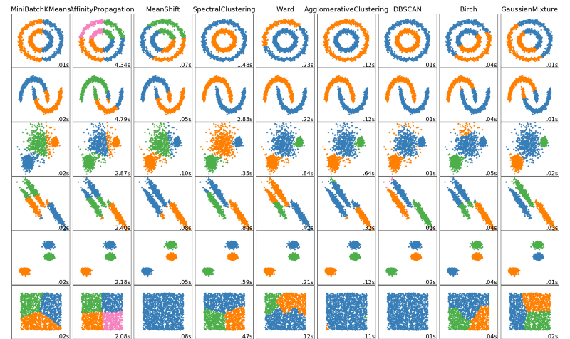
Cluster analysis
Group data points in clusters based on a distance criterion
Typically exemplified in 2D
Applies equally to our 24D situation!

Slide 4
Cluster analysis
Hierarchical clustering
Start with individual data-points
Define distance X
For each data-point, is there another point in range?
Combine points to cluster set
Define new distance X + Δ
For each data-point / cluster, is there another point/cluster in range
Combine points/clusters
Distance between clusters can be, say, average distance between constituent points (several methods to investigate)

Slide 5
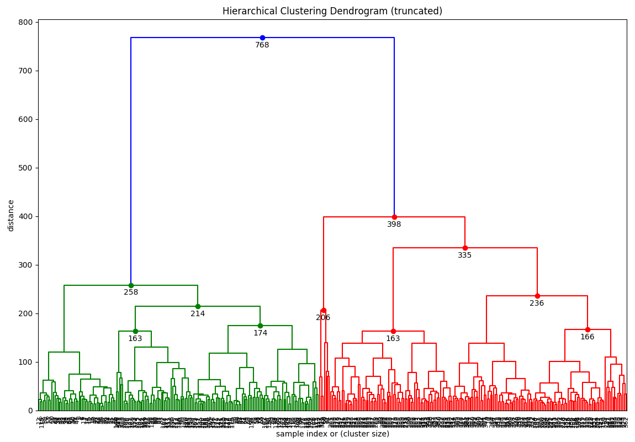
Example
Cluster analysis on cleaned 2018 day-ahead price data

Slide 6
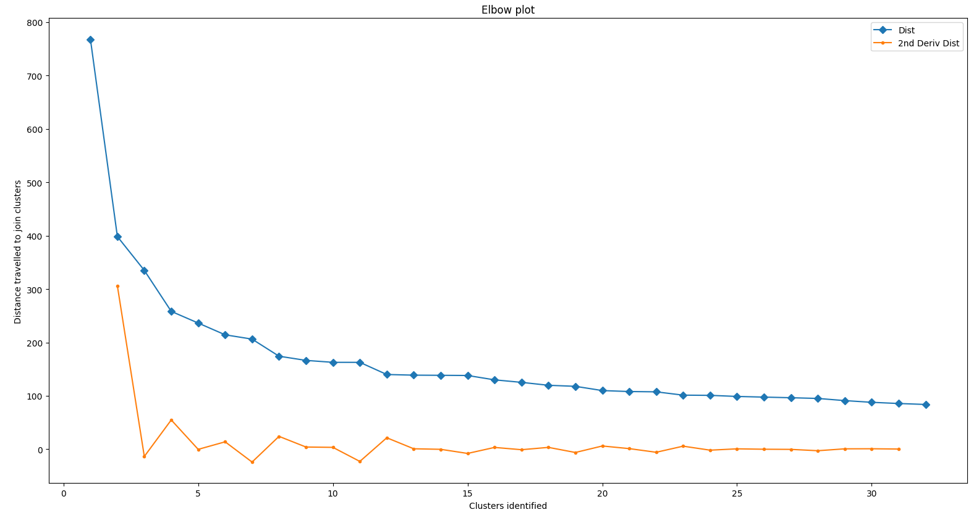
Example
Choice of cutoff distance is fairly subjective
Can be automated, e.g. elbow methods
But this doesn’t always work (https://joernhees.de/blog/2015/08/26/scipy-hierarchical-clustering-and-dendrogram-tutorial/)
n=2

Slide 7
My approach
Assign cut-off distance, retrieve cluster membership for each day, look for correlation with calendar.
See Excel sheet
There are 19 weeks where minimum price is consistently lower over weekend (and public holidays). Opportunity for net charging.

Slide 8
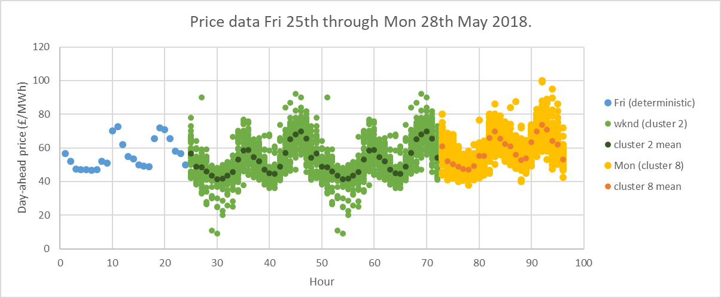
Schedule optimisation
From day 0 = Thursday 24th 2018:

Slide 9
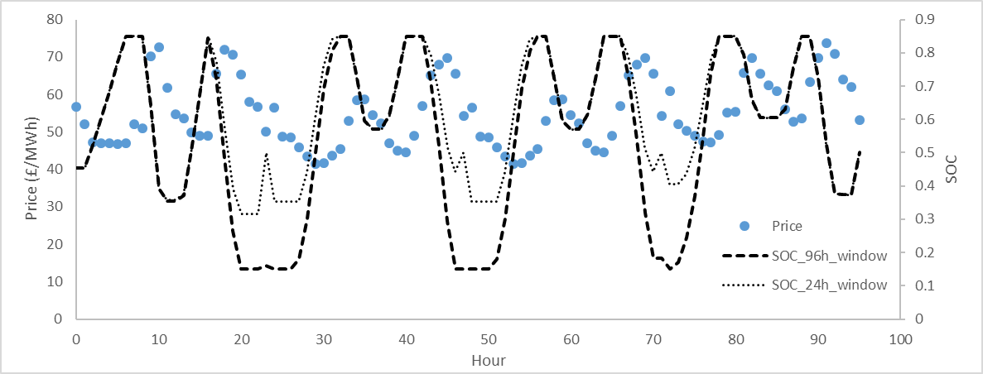
Schedule optimisation
Deterministic optimization against mean cluster values
4h rated RFB
96h window gives £0.167/kW v £0.138/kW for 24h x 4

Slide 10
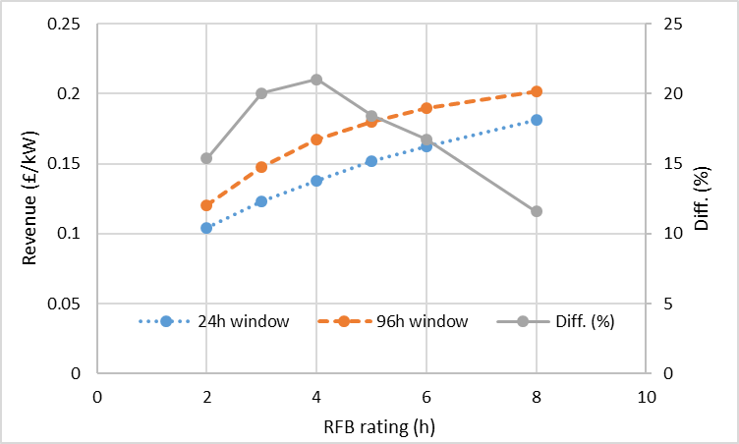
Schedule optimisation
Greatest increase to revenue when RFB duration is 4h.

Slide 11
Other ideas
Optimal RFB scheduling over three days involves idling at low SOC
This would be bad for a Li-ion battery

